Slide 1
MINI PROJECT TITLE A DATA MINING BASED MODEL FOR DETECTION OF FRADULENT BEHAVIOUR IN WATER CONSUMPTION

Slide 2
PROBLEM STATEMENT
Fraud behavior in drinking water is a major problem faced by water supply companies and agencies. This behavior results in significant losses in revenue and creates a very high percentage of non-technical losses. Finding effective rates for finding fraudulent jobs has become a viable area of research in recent years. Smart data mining techniques can help water supply companies to detect these fraudulent activities in order to minimize such losses. This study examines the use of two split strategies (SVM and KNN) to detect suspicious water customers. Our research introduces a novel data mining approach aimed at detecting fraudulent behavior in water consumption. With the increasing importance of water conservation and management, the identification of irregularities or fraudulent activities in water usage has become imperative. By leveraging machine learning algorithms and statistical analysis, our model can distinguish between normal usage patterns and aberrant activities, such as tampering with meters or unauthorized usage. Through the development and implementation of this model, we aim to provide water utility companies and authorities with an effective tool for mitigating losses due to fraud and ensuring the equitable distribution of water resources

Slide 3
PROPOSED SOLUTION
The main objective of this work is to use some well-known data mining techniques named Support Vector Machines (SVM) and K-Nearest Neighbor (KNN) to build a suitable model to detect suspicious fraudulent customers, depending on their historical water metered consumptions. The CRISP-DM (Cross Industry Standard Process for Data Mining) was adopted to conduct this research. To filter the data, some preprocessing operations were performed such as Eliminate redundancy, Eliminate customers having zero consumption through the entire period, Eliminate new clients who are not present during the whole target period, and Eliminate customers having null consumption values. . With the use of the proposed model, the water utilities can increase cost recovery by reducing administrative Non-Technical Losses (NTL’s).

Slide 4
EXISTING SOLUTIONS VS PROPOSED SOLUTION
Feature | Existing System | Proposed System
Detection Approach | Manual, rule-based systems | Automated using SVM and KNN
Data Usage | Limited, threshold-based | Full historical data analysis
Accuracy | Low (high false positives/negatives) | High (leverages machine learning)
Scalability | Not scalable, labor-intensive | Scalable, handles large datasets
Real-time Monitoring | Rare, mostly manual inspections | Automated, allows for real-time detection
Cost & Efficiency | High cost due to manual labor | Reduced costs, more efficient
Customer Impact | High false alarms, poor experience | Fewer false alarms, better experience

Slide 5
TECHNOLOGIES USED
Support Vector Machine (SVM) is a supervised machine learning algorithm used for classification and regression tasks. It works by finding the best boundary (hyperplane) that separates different classes in the data. SVM aims to maximize the margin between classes, using key data points called support vectors to define the boundary. For non-linearly separable data, SVM can apply a kernel trick to transform the data into a higher dimension. Its main goal is to classify new data points based on which side of the boundary they fall.
K-Nearest Neighbors (KNN) is a simple, supervised machine learning algorithm used for classification and regression tasks. It works by classifying new data points based on the "k" closest data points (neighbors) in the training dataset. When a new point needs to be classified, KNN looks at its nearest neighbors and assigns the most common class among them. For regression, it predicts the value by averaging the values of the neighbors. KNN is non-parametric, meaning it makes no assumptions about the data distribution, and its accuracy depends on choosing an appropriate value of "k."

Slide 6
Programming language: Python: Used for data manipulation, model building, and machine learning tasks. Python provides powerful libraries. Machine Learning Libraries: Pandas NumPy Matplotlib Scikit-learn Confusion Matrix Visualization Smote Seaborn

Slide 7
Hardware and Software Requirements: Hardware Requirements: System : Pentium IV 2.4 GHz. Hard Disk : 500 GB Ram : 4 GB Any desktop / Laptop system with above configuration or higher level Software Requirements: Operating system : Windows 8 / 7 IDE : Jupyter Notebook Framework : Anaconda Framework

Slide 8
TESTING: 1.Unit testing Initialization testing is the first level of dynamic testing and is first the responsibility of developers and then that of the test engineers. Unit testing is performed after the expected test results are met or differences are explainable/acceptable. 2.Integration testing All module which make application are tested . Integration testing is to make sure that the interaction of two or more components produces results that satisfy functional requirement. 3. System testing To test the complete system in terms of functionality and non functionality. It is black box testing, performed by the Test Team, and at the start of the system testing the complete system is configured in a controlled environment.

Slide 9
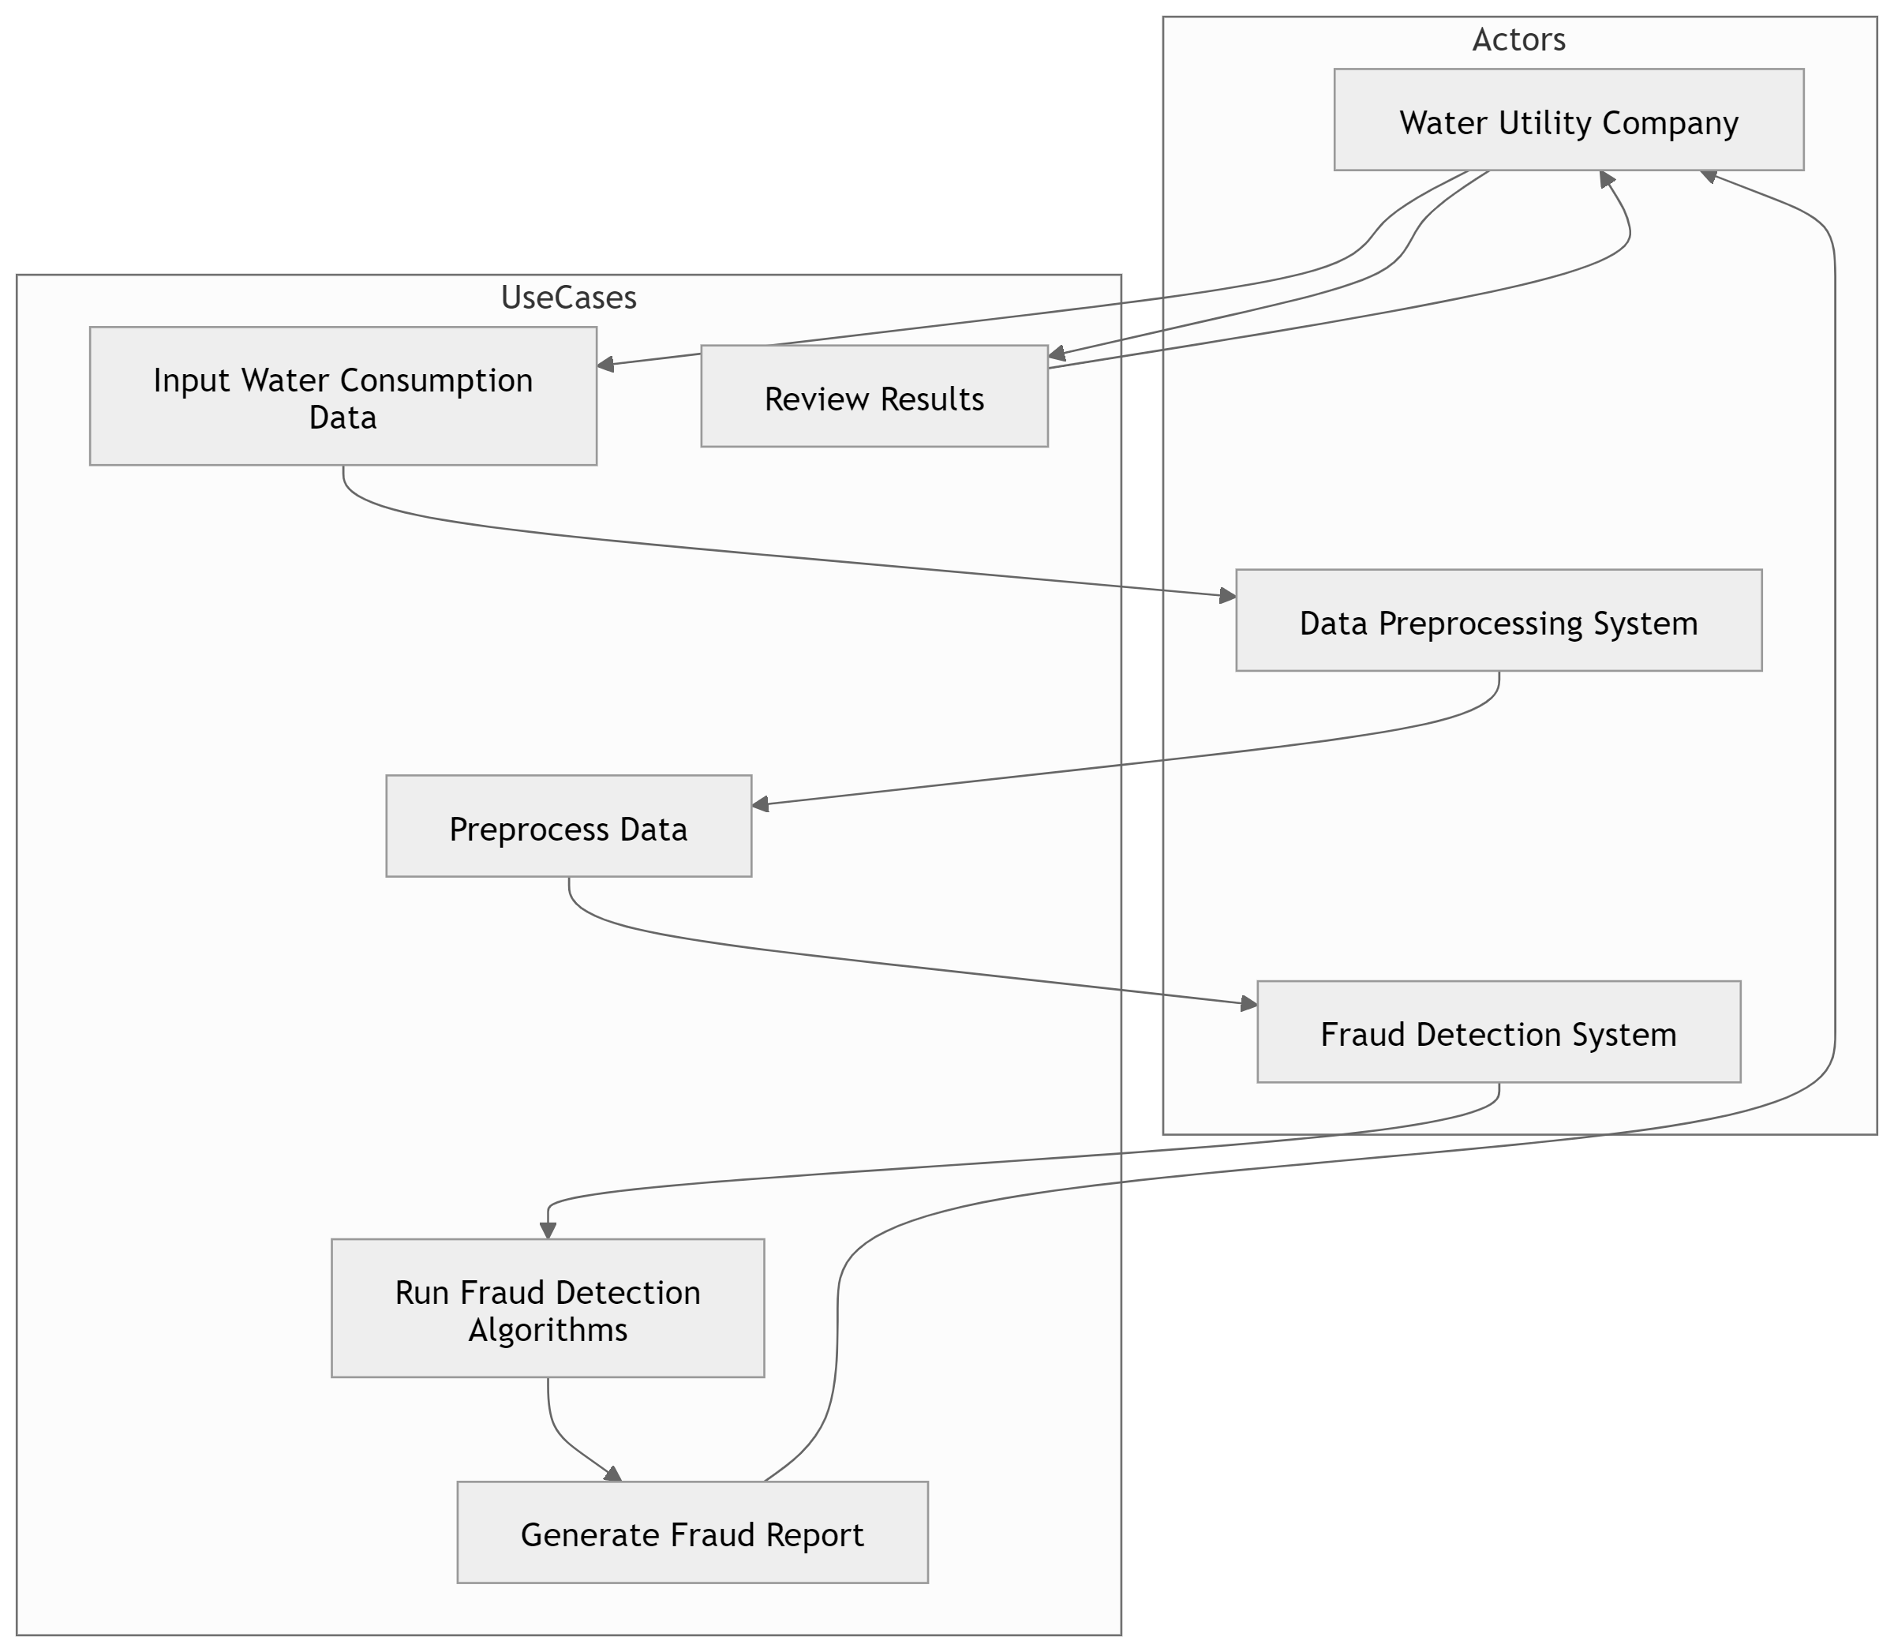
UML DIAGRAMS
User
USE-CASE DIAGRAM

Slide 10
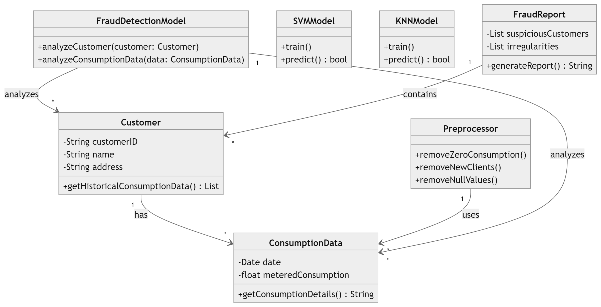
UML DIAGRAM CLASS DIAGRAM

Slide 11
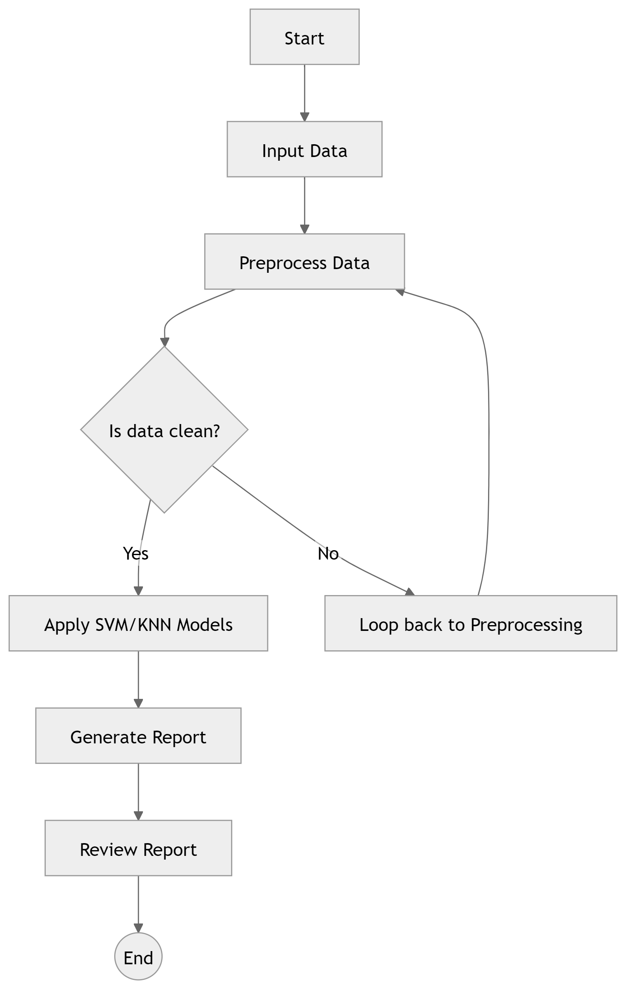
UML DIAGRAMS
ACTIVITY DIAGRAM

Slide 12
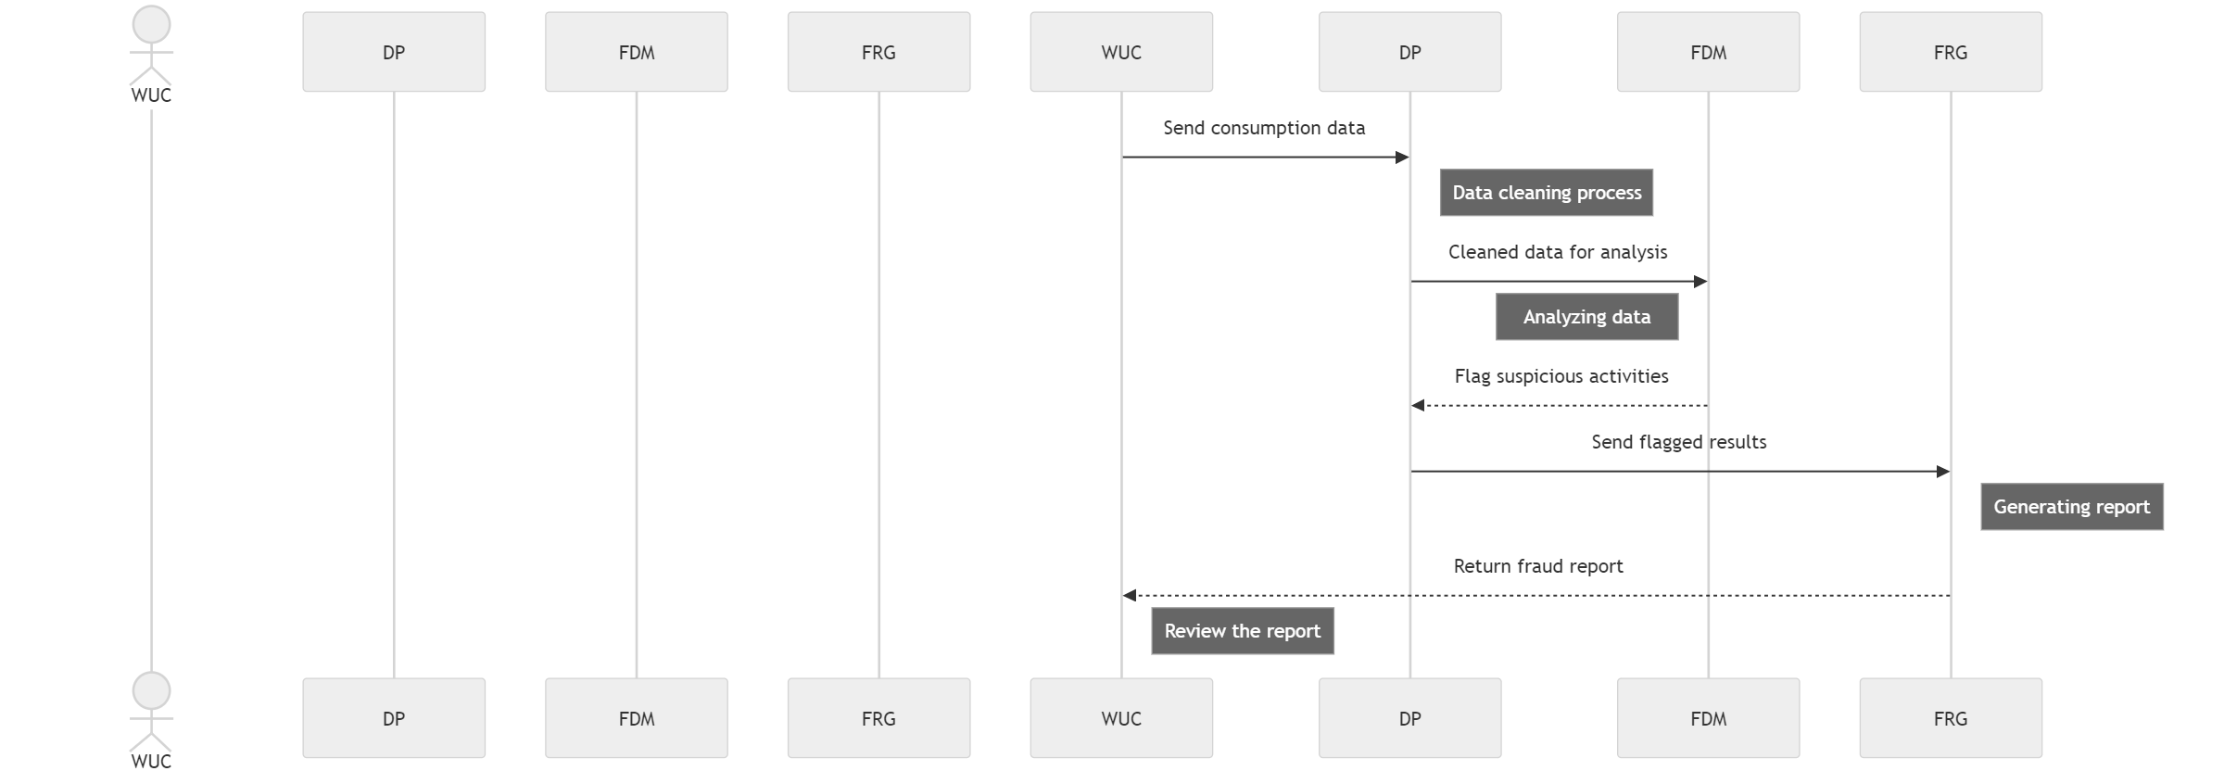
UML DIAGRAMS
SEQUENCE DIAGRAM

Slide 13
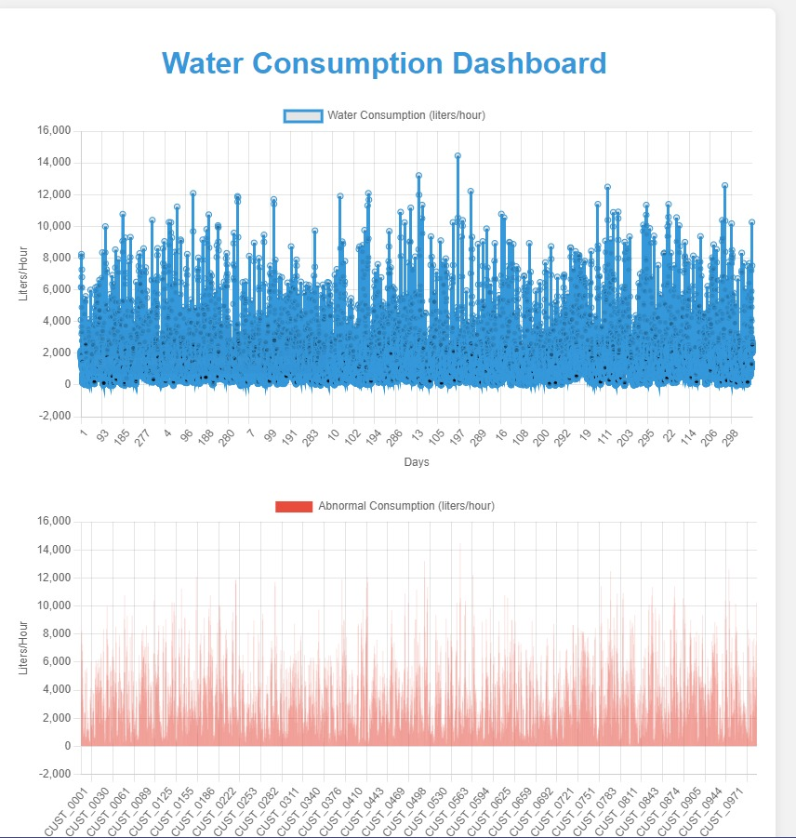

Slide 14
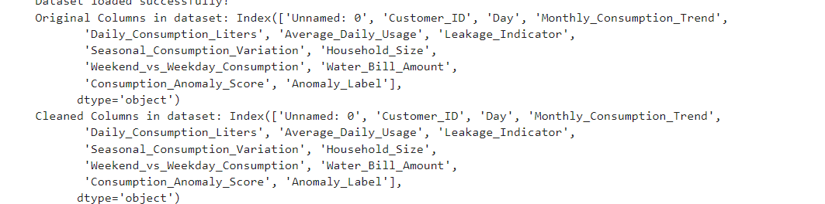
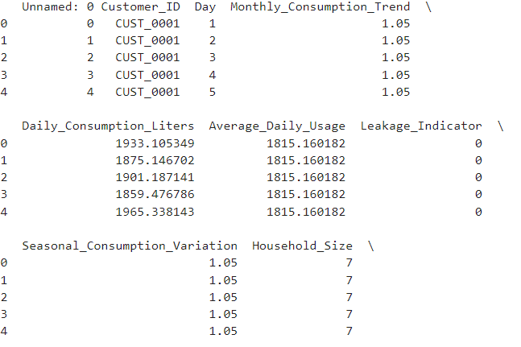
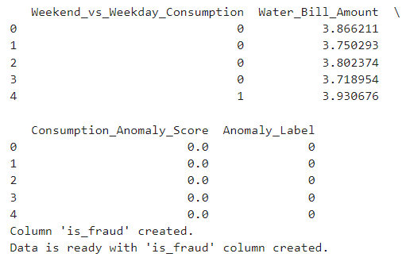
PROJECT OUTPUT
output screenshots

Slide 15
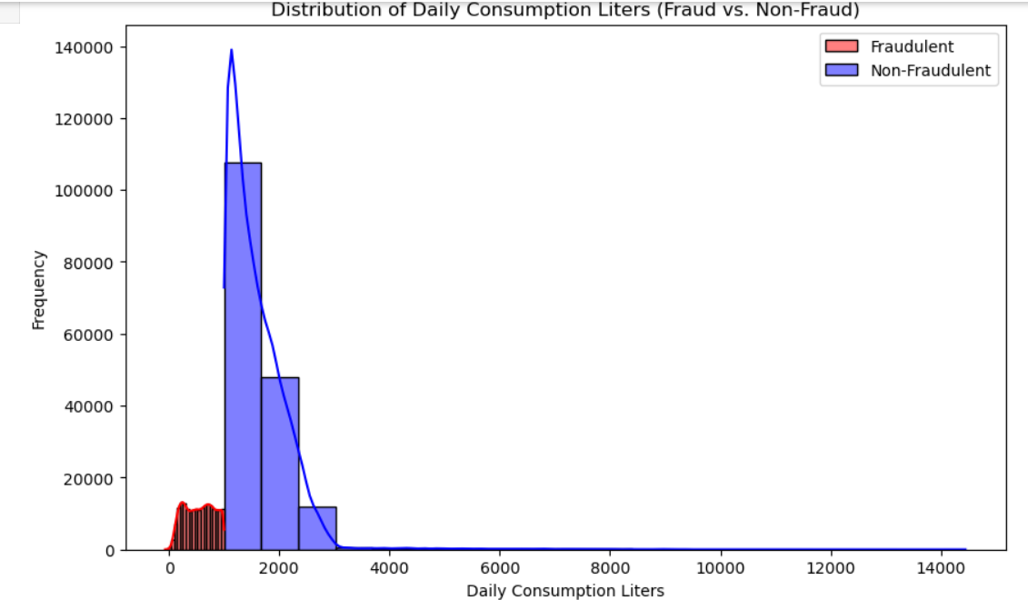

Slide 16
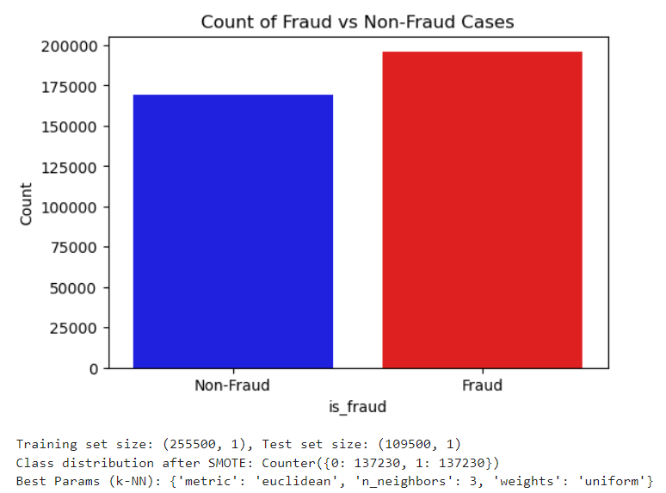

Slide 17
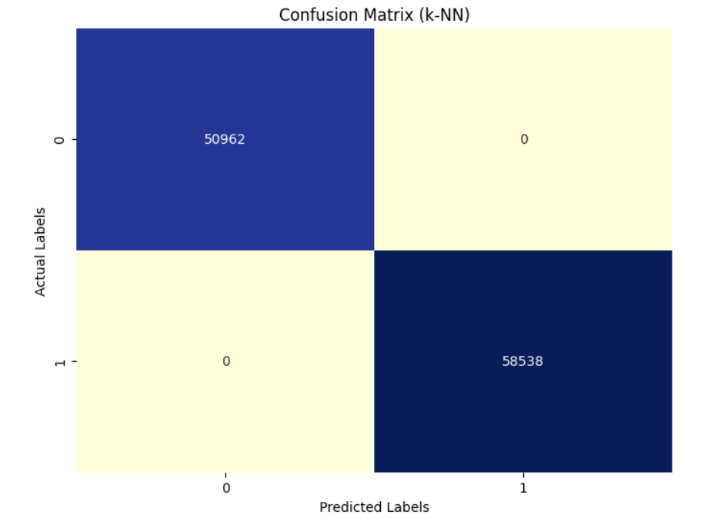

Slide 18
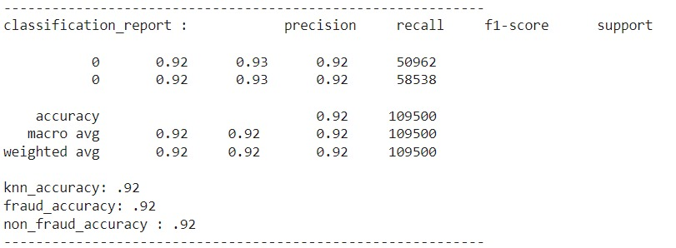

Slide 19
BENEFITS AND LIMITATIONS BENEFITS: 1. Early Detection of Fraud The model can identify unusual consumption patterns in real-time or near real-time, allowing for quick action. This early detection can help utility companies reduce revenue loss from undetected fraud. 2.Improved Accuracy with Time-Series Data Incorporating time-series analysis (e.g., ARIMA or LSTM models) helps the system understand seasonal, daily, or weekly consumption patterns. This improves the model’s ability to differentiate between normal and fraudulent behavior, reducing false positives. 3. Prevention of Water Wastage The system can also detect unusual spikes or drops in water usage, helping to identify not just fraud but also leaks or other inefficiencies in the water distribution system. This aids in overall water conservation efforts.

Slide 20
4.Continuous Learning and Improvement The model can be designed to learn from new data and flagged cases over time. As investigators mark false positives or confirm fraud cases, the model’s accuracy improves, leading to better fraud detection in the future. 5.Reduced Manual Effort Automated fraud detection drastically cuts down the time and effort required for manual reviews or audits. Investigators can focus on high-risk cases flagged by the system, increasing efficiency.

Slide 21
LIMITATIONS
1. Limited Features for Fraud Detection : The system may only use a small set of features, such as water consumption data, for fraud detection. More complex patterns of fraudulent behavior might require additional data points like historical usage, location, time of consumption, and user demographics to improve accuracy.
2. Data Imbalance : Fraudulent behavior in water consumption is typically rare compared to normal usage. This class imbalance could lead to models being biased towards the majority class (normal behavior), resulting in a high number of false negatives (missed fraud cases).
3. Lack of Real-Time Analysis : The system may not offer real-time fraud detection, meaning that fraudulent activities could go unnoticed for a significant period before they are flagged. This delay in detection could be problematic for identifying and stopping fraud early.
4. Limited Generalization to Different Regions :Water consumption patterns vary widely across regions due to differences in climate, infrastructure, and user behavior. A model trained on data from one region might not generalize well to another region without significant adjustments.

Slide 22
5. Limited Generalization to Different Regions :Water consumption patterns vary widely across regions due to differences in climate, infrastructure, and user behavior. A model trained on data from one region might not generalize well to another region without significant adjustments. another region without significant adjustments. 6. No Incorporation of External Factors : External factors like water pricing policies, government restrictions on water usage, or economic conditions could influence consumption patterns. The system may not take these factors into account, which could impact its fraud detection accuracy.15. Reliance on Historical Consumption Patterns:

Slide 23
CONCLUSION
Data mining is a valuable tool for spotting fraud in water usage. By using data analysis techniques, water utilities can better identify fraudulent activities, save money, and promote fair usage among customers. As technology continues to improve, these methods will only get better, helping ensure that water resources are managed effectively and sustainably. Ultimately, the insights from data mining lead to smarter decisions, better service, and a fairer system for everyone.
PROJECT GUIDE
conclusion

Slide 24
FUTURE ENHANCEMENTS 1.Integration with IoT Devices: Description: Utilize smart water meters and IoT sensors that continuously monitor water usage and transmit data to a central system. Benefits: This allows for more granular data collection and enables automated alerts for unusual consumption patterns 2.Cloud-Based Solutions: Description: Deploy the fraud detection system on a cloud platform to enable scalability, flexibility, and easier data access. Benefits: Enhances collaboration between different departments and simplifies the integration of new data sources.

Slide 25
THANK YOU

